Slide 1

Customer Retention
PPt presented by:-
Diptiranjan Pradhan
Intern of FlipRobo Technologies
Under Guidance of:-
Swati mahaseth

Slide 2
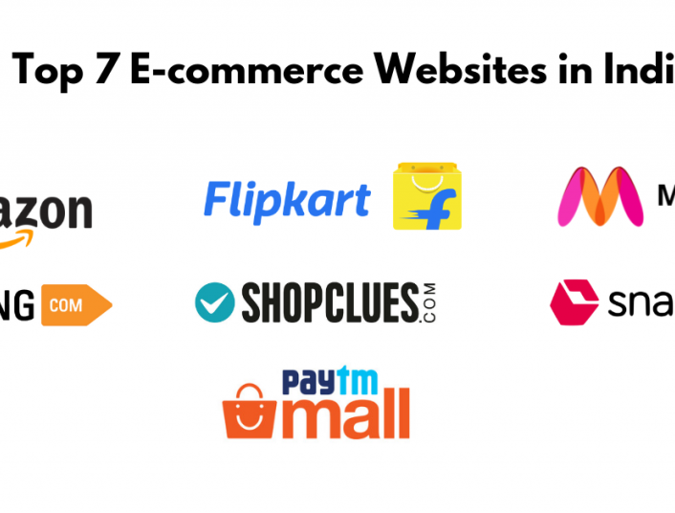
Ecommece sites
These are some of india’s top ecommerce sites.

Slide 3
Basic summery of our dataset:-
- This Dataset contains data of Indian E-commerce website that has the user data such as gender ,age ,location and 71 other columns of data about the activity of the user in the website.
-which website we would recommend to our friends is the imp thing here. We could analyse and find which factors affect the recommendation of the users.
-The dataset which given to us has contains 269 rows and 71 columns.

Slide 4
EDA:-
-In this EDA process we have to analyse the data which were given in our dataset.
-There 269 columns and 71 rows are present in this dataset.we can also call it as shape of the dataset.
-In this dataset there is no null values are present.
-Then lets analysis the data in plotting form…>>>

Slide 5
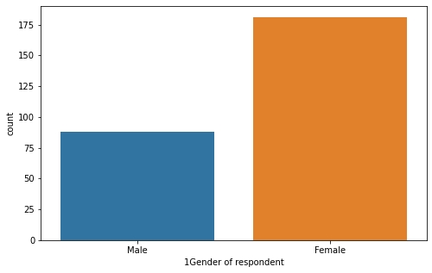
Age:-
-As we can see around 175 females are doing online shopping where as male are around 80-90.
-So here we get to know more females are likely do online shopping than men.

Slide 6
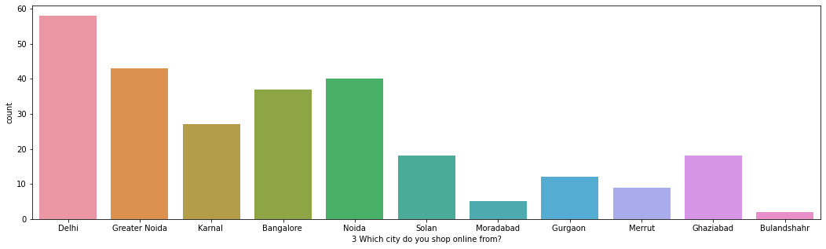
City:-

Slide 7
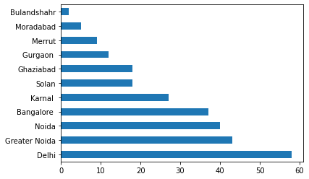
→ As we can see from Delhi most no of customer are shopping.
After Delhi,customers are from Greater Noida,Noida,and Bangalore are top3 cities respectively.

Slide 8
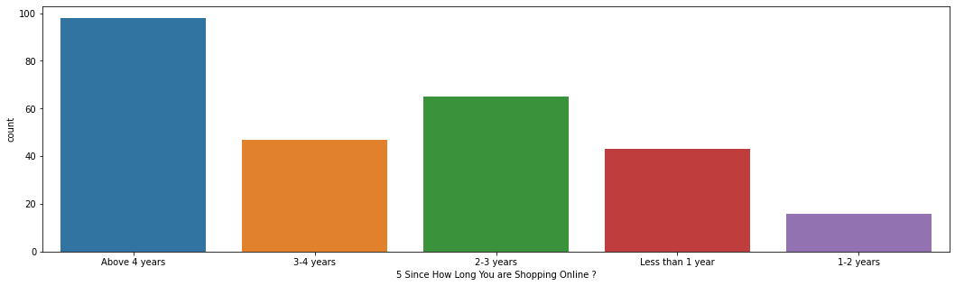
Shopping Experience-

Slide 9
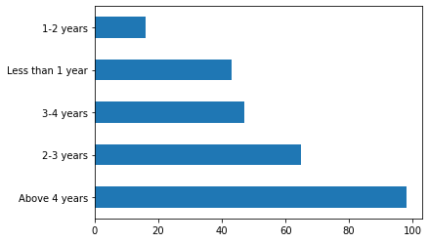
→ About 100 customers are shopping from more than 4 years where as more than 40+ customers have 3-4yrs of experience & 60+ customers has 2-3 years experience in online shopping.

Slide 10
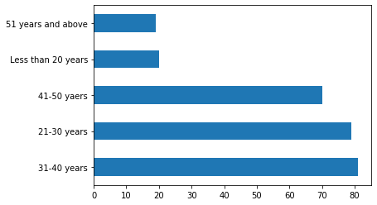
Age:-
→ As we can see 20-40 years old people mostly shopping from ecommerce sites 41-50 age peoples are also likely to shopping from ecommerce sites.

Slide 11
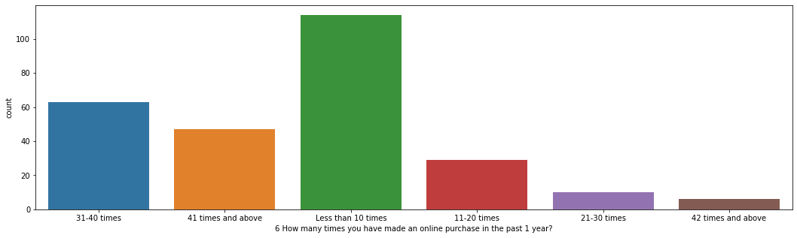
*Shopping how much Times:-
→From this fig we came to know that maximum customers more than 100 customers are shoping less than 10 times in past 1years.
→More than 60 customers are shopping between 31-40times.
→40+ customers are shopping 41 times or more than it.

Slide 12
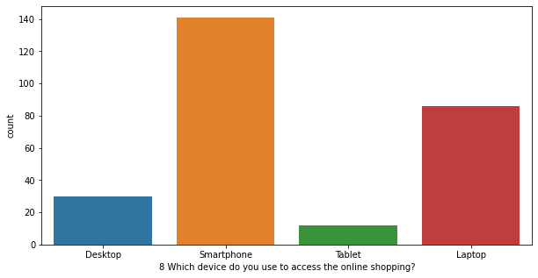
Device used for shopping:-
→Maximum no of customers are used their smartphones for shoping
→after smartphone customers like to shopping from laptop,den desktop & tablet accordingly.

Slide 13
There are many parameters like this…But now we are going to discuss some main factors or parameters for customer retention…
Lets see how important those factors for customer retention…

Slide 14
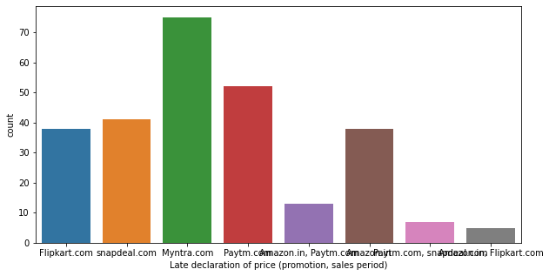
Late Declaration of price:-
→There are some sites which are declare the price of products very late. Those sites are Myntra , Snapdeal , Paytm.
→Generally customers wants to know the price of a product 1st.
→When some sites declare their price late there is a huge chance to customers go for another site.

Slide 15
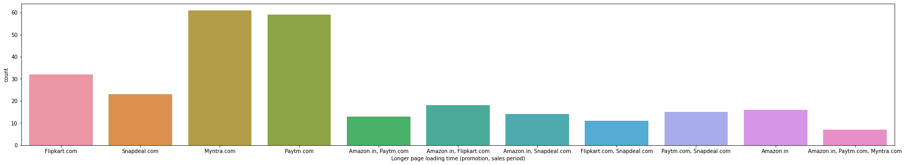
Longer page loading time:-
→Time is very precious. When customer gives there time for shopping they wants the page to be load as fast a possible.
→But here paytm and myntra have take longer time period for loading…
→It may be a reason for customers to go in another ecommerce platform.

Slide 16
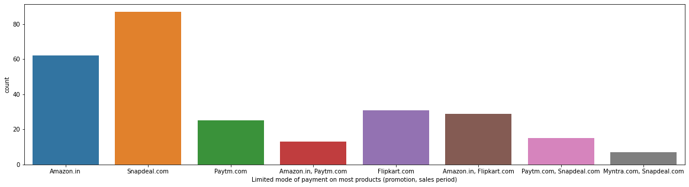
Limited mode of payment:-
→Normally customers needs option in almost all field.. in payments mode also customer need various mode for payments like- credit card, debit card, emi, pay latter, crypto etc etc..
→But not all sites gives that facilities to there customers…
→we can clearly see Among those all sites snapdeal is a company that provides very less payment modes.. So it is also a very imp factor for customer retention.

Slide 17
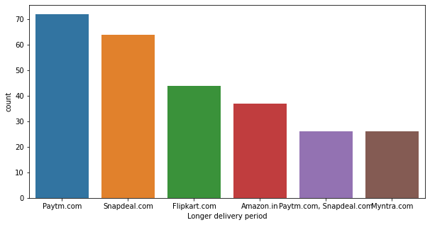
Longer delivery period:-
→Almost all customer need there product reach to them as soon as possible. customer just hate delay in delivery system.
→Paytm and snapdeal takes longer time for delivery, which is directly impact on customer satisfaction or retention…
→So maxm customer go for the sites who take least time for delivery.
This is most important factor for customer retention.

Slide 18
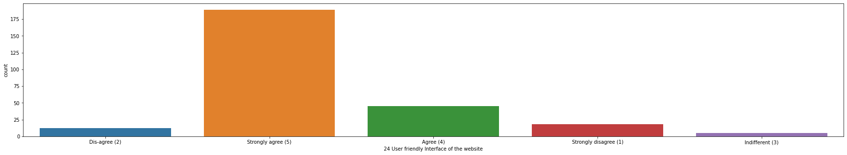
User friendly Interface:-
→All customer needs a surface which is easy for use. So almost all sites tries to do a user friendly interface for their users .If some sites interface is nor easy or user friendly then it leads to change someone mind to change or switch to some user friendly platform…
→So it is most imp to do a user friendly platform for shopping.

Slide 19
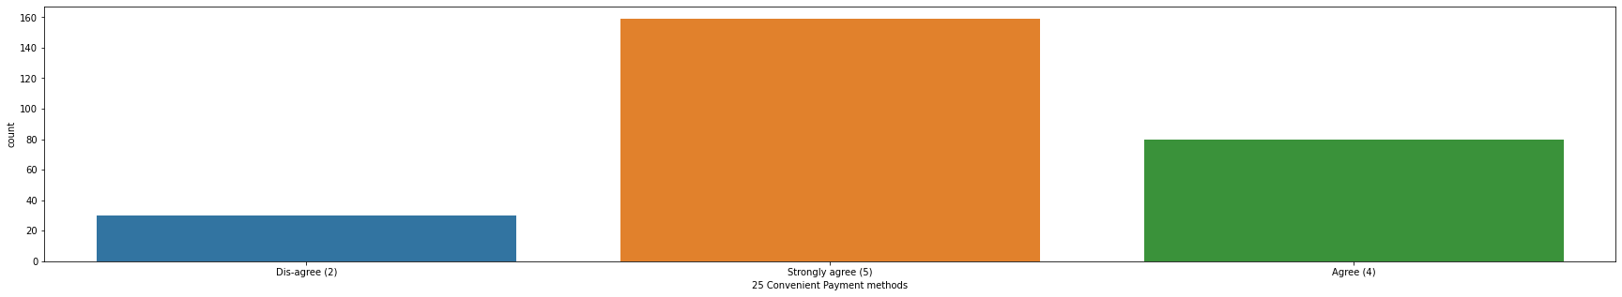
Convenient Payment methods:-
**→if we talk about customer retention I think It is one of the most imp factor. All customer needs good payment method which is suits to him/her.
-There are many payment modes are available in market..
→*Those platform which have various types of payment accept mode customers will attract to them..

Slide 20
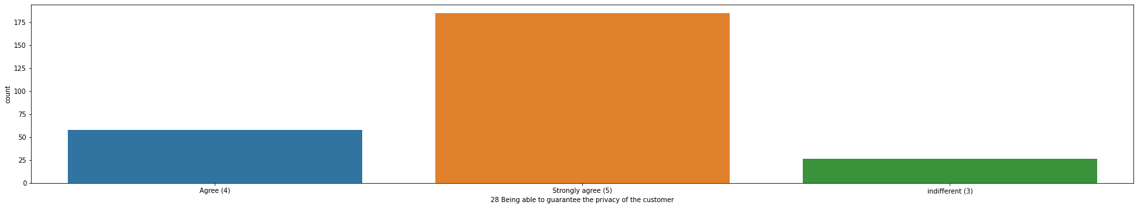
Privacy of the customer:-
→Almost all customer wants to keep there privacy safe.
*So customer will go for those platforms who keep privacy very safe….
--So it is also a imp factor for customer.

Slide 21
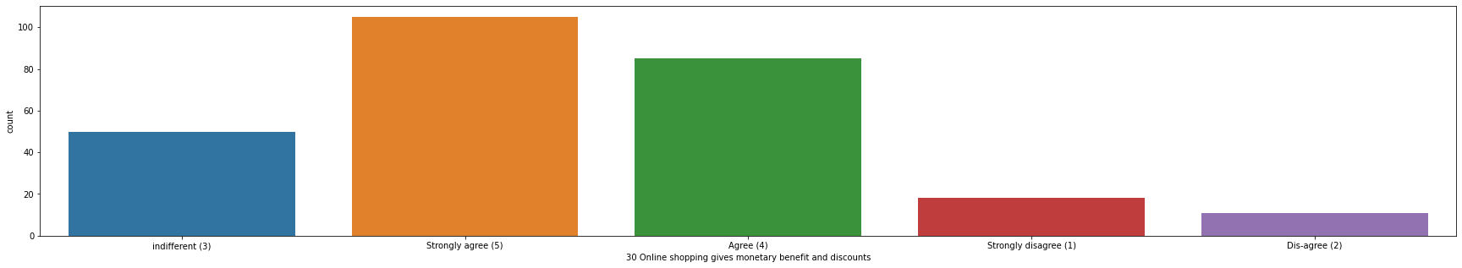
Monetary benefit and discounts and savings:-
→Ecommerce sites gives best deals at best price as compare to offline market. So customers attracted towards where they get same product at a discounted price.
→So it gives huge savings of money as compare to offline.
→So maxm customer agree that ecommerce sites gives them monetary benefits and savings.
→Ecommerce sites gives a lot of discounts to attract customers.
→** So it is very imp for customer retention.

Slide 22
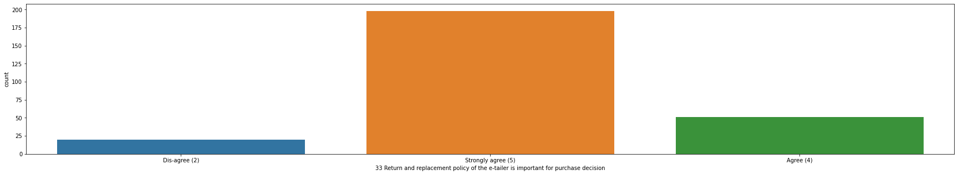
Return and Replacement Policy:-
Almost all customer strongly agree that they do prefer for shopping from those sites who has a very good return and replacement policy…
This is the most imp for ecommerce sites and for customer retention also.

Slide 23
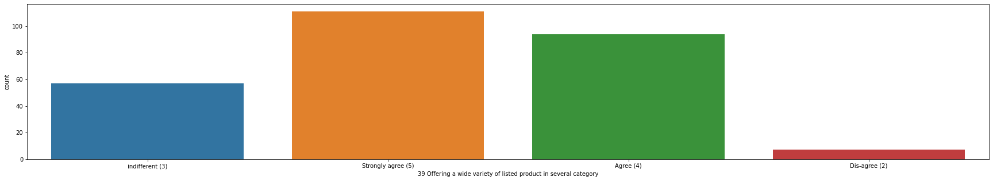
Variety of listed product:-
Customers are always wants some variety in several categories products.
Maxm customers strongly agree that the site which have variety of products customers are likely attracted toward that site..
So variety of products are very imp for customer retention.

Slide 24
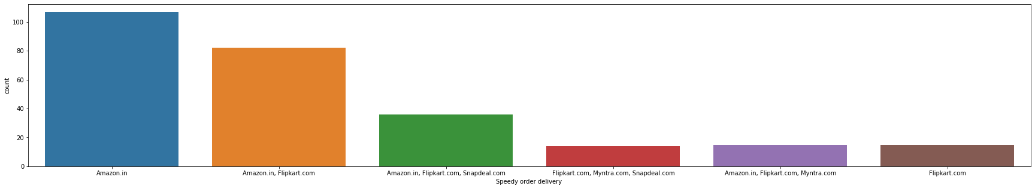
Speedy order delivery:-

Slide 25
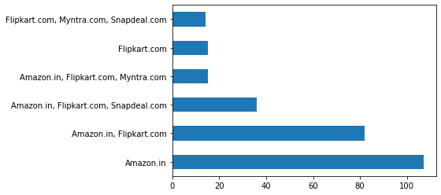
Almost all customer Agree that they are most likely to shopping from those sites who has speedy order delivery of products.
Customers are just don’t like late deliveries so it is one of the best parameter for attract customers or retention the customers.
Here we can clearly see Amazon and flipkart are doing faster delivery…
This is one of the best parameter for customer retention..

Slide 26
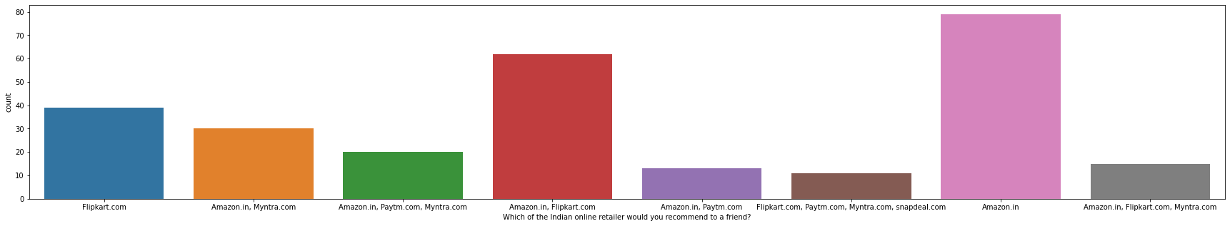
Which of the Indian online retailer would you recommend to a friend?
This is the final or target part of the dataset …
From our data set maximum people or customer recommended Amazon and Flipkat and Myntra accordingly for online shopping…

Slide 27

Thank You
The above parameters which we discussed are the main reason for a customer retention…

